Slide 1
Chapter 5: Discrete Probability Distributions

Slide 2
Section 5-1 Probability Distributions

Slide 3
Recall from the past!
Variable- characteristic or attribute that can assume different values
Discrete variable- a variable can only assume a specific number of values
Continuous variable- variables that can assume all values in the interval between any two given values

Slide 4
Random Variables
A variable whose values are determined by chance
Examples:
If a die were rolled, RV X would represent possible outcomes: 1,2,3,4,5 or 6.
If two coins were flipped, RV Y would represent # of heads: 0,1,2

Slide 5
Random Variables Cont’d
Take a minute to think of your own!
We will only be talking about discrete random variables in this chapter
Chapter 6 is continuous random variables

Slide 6
Discrete vs Continuous Variables
Discrete: have a finite number of possible values or infinite number of values that can be counted
Ex. # of joggers in a park

Slide 7
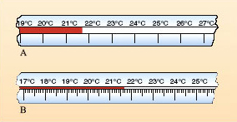
Continuous: can be all values in an interval between two given values
Ex. Temp ranges from 20 degrees to 34 in a 24-hour period
Again..let’s think of own examples

Slide 8
Example of Probability Distribution
No Heads | One head | Two heads | Three heads
TTT 1/8 1/8 | TTH THT HTT 1/8 1/8 1/8 3/8 | HHT HTH THH 1/8 1/8 1/8 3/8 | HHH 1/8 1/8
Number of Heads X | 0 | 1 | 2 | 3
Probability P(X) | 1/8 | 3/8 | 3/8 | 1/8

Slide 9
Requirements for a Probability Distribution
1. The sum of the probabilities of all the events in the sample space must equal 1; that is, ∑P(X) = 1.
2. The probability of each event in the sample space must be between or equal to 0 and 1. That is, 0 ≤ P(X) ≤ 1

Slide 10
Lets see for ourselves
Each student will flip a coin three times and record how many of those three flips landed on heads
Predictions?
HW: 1,2,7-9

Slide 11
Making a probability distribution
Step 1: Make a frequency distribution for the outcomes of the variable.
Step 2: Find probability of each outcome by dividing frequency of the outcome by the total sum
Step 3: If making graph, place probability on Y axis and outcomes on X axis

Slide 12
Let’s Make one Together
Random Variable: The amount of students who eat hot lunch

Slide 13
Homework 5-1
P. 263 #1, 2, 7-9, 19-20

Slide 14
5-2 Mean, Variance, S.D., Expectation

Slide 15
MeAN
Recall:
Sample mean: $\overline{X}$ = $\frac{∑X}{n}$
Population mean: $μ \text{= }\frac{∑X}{N}$
Mean for probability distribution: (***NEW***)
$μ$= $X_{1}∗P(X_{1}$) + $X_{2}∗P(X_{2}$) + … + $X_{n}∗P(X_{n}$)
$μ$= $∑X$ * P(X)

Slide 16
Example for Probability Distribution Mean
Outcome X | 2 | 4 | 6 | 8
Probability P(X) | 0.20 | 0.40 | 0.32 | 0.08
Number of batteries sold over the weekend at a convenient store
$μ$= 2$∗0.20$+ 4$∗0.40$+ $6∗0.32$+ 8 * 0.08 = 4.56

Slide 17
Variance and Standard Deviation
New for probability distributions:
${ \text{σ}}^{2}= ∑{[(X−μ)}^{2}$ $∗$ P(X)]
Above is tedious, so we actually use:
${ \text{σ}}^{2} = ∑[X^{2}$ $∗$ P(X)] -$μ^{2}$
σ = $\sqrt{∑[X^{2} ∗ \text{P}\text{(}\text{X}\text{)] −}μ^{2}}$
Recall from Ch. 3:
${\text{Variance} \text{σ}}^{2}= \frac{∑{(X−μ)}^{2}}{N}$
S.D. σ $= \sqrt{\frac{∑{(X−μ)}^{2}}{N}}$

Slide 18
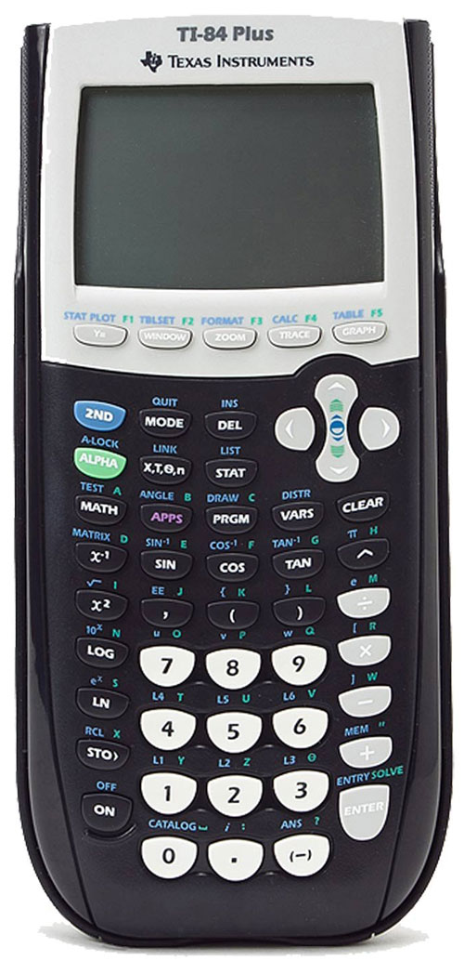
How to put it in Calculator
1) Stats -> Edit
2)X values in L1 and P(X) values in L2
3) Stats-> Calc -> 1-Var Stats
4) 2nd -> List L1, L2
5) then $\overline{X}$ = mean, σx = S.D.

Slide 19
Number of balls X | 3 | 4 | 5
Probability P(X) | 2/5 | 1/5 | 2/5
Mean: $μ$= $∑X$ * P(X) = 3 * (2/5) + 4 * (1/5) + 5 * (2/5) = 4
Variance: ${ \text{σ}}^{2} = ∑[X^{2}$ $∗$ P(X)] -$μ^{2}$ = $3^{2}∗\frac{2}{5}+ 4^{2}∗\frac{1}{5}+5^{2}∗\frac{2}{5}−16$
= 16$\frac{4}{5} −16$
= .8 or $\frac{4}{5}$
Standard Deviation: $\text{σ}$ = $\sqrt{{ \text{σ}}^{2}}$
= $\sqrt{\frac{4}{5} }$ = 0.894

Slide 20
$10
$1
$1
-$6
SPIN
-$4
$1
$1
-$5
tekhnologic
Notes:
8 Segments

Slide 21
Expected Value
Discrete random variable of a probability distribution is the theoretical average of the formula
E(x) = $μ$ = $∑X$ * P(X)
Used often when referring to money
Theoretical average

Slide 22
Let’s find the expected value of the spinner
(4/8)*1 + (1/8)*10 + (1/8)*-4 + (1/8)(-5) + (1/8)(-6) = -(1/8) = -$0.125

Slide 23
Section 2 Homework
P. 272 1-4, 13-15

Slide 24
Expected Value Project
We are going to create our own game, but you have to figure out a way to have an Expected Value of zero
Here are the stipulations:
At least 8 zones
All must have different numbers
Expected value = 0

Slide 25
Binomial Distribution 5-3

Slide 26
Binomial Distribution
-when probability trials have only TWO outcomes
- ex. Basketball team either wins or loses, heads or tails, correct or incorrect

Slide 27
Binomial Experiment Requirements
Binomial experiment- probability experiment that satisfies the following four requirements:
There must be a fixed number of trials
Each trial can only have TWO outcomes or outcomes that can be reduced to two outcomes such as success or failure
The outcomes of each trial must be independent of one another
The probability of success must remain the same for each trial

Slide 28
Determining if Situations are Binomial
Selecting 20 university students and recording their rank.
No
Selecting 20 university students and recording if they are on dean’s list or not.
Yes
Drawing 5 cards and recording if each card is red or black without replacement.
No
Drawing 5 cards and recording if each card is red or black with replacement.
Yes
Let’s try it

Slide 29
Binomial Distribution Formula

Slide 30
Example
A coin is tossed 3 times. Find the probability of getting exactly 2 Heads. We know the answer is 0.375 from previous information, but let’s check the formula
We know n = 3, X = 2, p = ½, q = ½
$$\frac{3!}{\left(3−2\right)!2!}∗{\left(\frac{1}{2}\right)}^{2}∗\left(\frac{1}{2}\right)=\frac{3}{8}=0.375$$

Slide 31
Another one
A survey found that 40% of PV students have part time jobs. If 5 PV students are selected at random, find the probability that AT LEAST 3 will have part time jobs.
P(3)= $\frac{5!}{\left(5−3\right)!3!}{(0.4)}^{3}{(0.6)}^{2}$ = 0.230
P(4)= $\frac{5!}{\left(5−4\right)!4!}{(0.4)}^{4}{(0.6)}^{1}$ = 0.077
P(5)= $\frac{5!}{\left(5−5\right)!5!}{(0.4)}^{5}{(0.6)}^{0}$ = 0.010
0.230+0.077+0.010 = 0.317

Slide 32
How to put it in Calculator
1) 2nd -> Vars (Distr)
2)Scroll down until “binompdf”
3) Type in such that binompdf(n,p,x)

Slide 33
If you are given the binomial Distribution
Here is how you find the mean, variance, standard deviation
Mean: μ = n * p Variance: ${\text{σ}}^{2}=n ∗p ∗q$ S.D.: σ = $\sqrt{n∗p∗q}$

Slide 34
Section 5-4 Other types of Distribution

Slide 35
Multinomial Distribution
Like the binomial distribution, but with more than 2 outcomes
- Like a survey with options for ‘agree’, ‘disagree’, and ‘no opinion’

Slide 36
Multinomial cont
-Same requirements as binomial distribution, but more than two outcomes per trial.
$P\left(X\right)= \frac{n!}{X_{1}!X_{2}!X_{3}!…X_{k}!}∗p_{1}^{x_{1}}$* $p_{2}^{x_{2}}∗…p_{k}^{x_{k}}$

Slide 37
Example 1
A bag contains 4 white balls, 3 red balls, and 5 blue balls. A ball is selected at random, its color is recorded, and then the ball is replaced. Find probability if 5 balls are selected, two are white, two are red, and one is blue.
N=5, $X_{1}=2,P_{1}=\frac{4}{12},X_{2}=2,P_{2}=\frac{3}{12},$ $X_{3}=1,P_{3}=\frac{5}{12},$
$P\left(X\right)= \frac{5!}{2!2!1!}{(\frac{4}{12})}^{2}{(\frac{3}{12})}^{2}{(\frac{5}{12})}^{1}$= 0.0868

Slide 38
Another Example
Suppose a card is drawn randomly from an ordinary deck of playing cards, and then put back in the deck. This exercise is repeated five times. What is the probability of drawing 1 spade, 1 heart, 1 diamond, and 2 clubs?
Variables…
$P\left(X\right)= \frac{5!}{2!1!1!1!}{(\frac{13}{52})}^{1}{(\frac{13}{52})}^{1}{(\frac{13}{52})}^{1}{(\frac{13}{52})}^{2}$= 0.0586

Slide 39
Poisson Distribution

Slide 41
Poisson Distribution
This distribution is useful when N is large and p is small
Random Variable X is number of occurrences over an interval
For example, the number of phone calls per hour
Info given P(X, λ) and λ = n * p

Slide 42
Example 1
If approx. 2% of the people in a room of 200 people are left-handed, find the probability that exactly 5 people are left-handed.
X = 5, λ = 200*(0.02) = 4
$$P(5;4\text{) = }\frac{e^{−4}4^{5}}{5!}=0.1563$$

Slide 43
Example 2
If there are 200 typographical errors randomly distributed in a 500 page manuscript, find the probability that a given page contains exactly 3 errors.
λ=200/500 = 0.4
P(3;0.4) $\text{= }\frac{e^{−0.4}{0.4}^{3}}{3!}=\text{0.0072}$

Slide 44
Main ideas For Chapter
Think…
Can you make a probability distribution (chart and graph) and understand it?
Calculate mean, S.D. and variance of PD?
Find an expected value?
Determine if a situation is binomial or not and find the probability?
Use multinomial and Poisson distributions?

