Slide 1
Chapter 2 – Frequency Distributions and Graphs
(All about GATHERING, ORGANIZING (frequency table/distribution) & REPORTING (charts and graphs) DATA

Slide 2
2-1: Frequency Distribution
An organized table of the raw data
Classes (categories)
Frequencies (how many/tallies)
OPEN up book…look at top of page 43
3 types
Categorical (like the bottom of page 43)
Grouped (top of page 43)
Ungrouped (top of page 50)
STEPS (awesome) for each are in book right here (let’s look at the steps for each)

Slide 3
Important Features to a GROUPED Frequency Distribution/Table
Class limits
All classes are the SAME size (class width) – can check it two ways
Lower class limit – next lower class limit (or upper – upper)
Subtract upper class boundary – lower class boundary
DO NOT: top – bottom of any class limit (it won’t get you the correct answer)

Slide 4
Class boundaries (just like what we found in chapter 1)
Half of a unit above and below the last placeholder position for each class
Separates classes so there are NO gaps
Not always included in a frequency table
Example on bottom of page 44 (2nd column)

Slide 5
STEPS FOR CONSTRUCTING FREQUENCY DISTRIBUTIONS/TABLES
Use between 5 and 20 classes
We will usually use 10 or less
TRY to make class width an odd value
Helps make the midpoint of the class be a nice round value
Classes must be mutually exclusive (no overlapping)
Classes must be continuous (don’t skip values – even if you don’t have any of them)

Slide 6
STEPS FOR CONSTRUCTING FREQUENCY DISTRIBUTIONS/TABLES (cont)
Classes must be exhaustive (include all data – don’t leave any values out)
Classes must be equal in width
There is an exception: if the first OR last class is open ended (bottom of p.46)
Find the highest and lowest values and subtract (range)
Determine the # of classes you want
Divide the range by # classes and ALWAYS ROUND UP
If it is a whole number, add one more class
Select a starting point (usually the lowest data value)
Add the width to get the class limit
Find boundaries (these are not ALWAYS included)
Tally data
Total tallies AND find cumulative frequencies

Slide 7
Let’s try one together….
p. 51: Applying the concepts (Ages of Presidents at Inauguration)

Slide 8
ASSIGN:
fix/complete p. 51: 2-5 all AND add 7-10

Slide 9
2-2: Histograms, Frequency Polygons and Ogives- graphs
Turns data (table format) into a picture (graph)
Histograms: bar graphs Frequency Polygons: dots connected with a line
Ogives: like a frequency polygon but using the cumulative frequencies instead of the frequency, so line continues to rise

Slide 10
Steps for all 3 types of graphs
Draw AND label the x and y axes
Histograms use class boundaries (x –axis)
Frequency polygons use class midpoints (how to find – in 2 slides)
Ogives use class boundaries (x –axis)
Plot the frequencies for each class (y – axis)
Histograms will need vertical bar (frequency)
Frequency polygons and Ogives will need points/connected with lines (frequency and cum frequency)

Slide 11
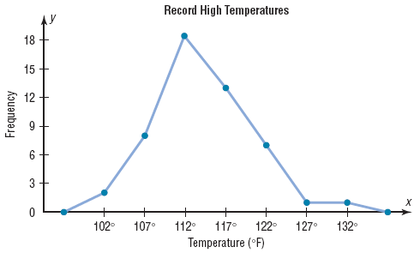
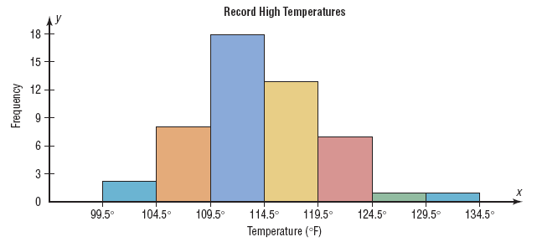
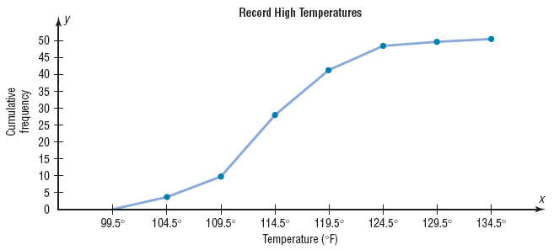
Here is the same data represented 3 different ways

Slide 12
How to calculate the midpoint
Add the upper and lower class boundary and divide by 2
OGIVE: uses the cumulative frequency on the
y – axis
Show how many values are below a certain upper class boundary
Label the x and y – axes with numbers AND labels

Slide 13
Example of a frequency table with each picture and how to build on the board
p. 53: 23

Slide 14
Now, try the graphing (the NEXT day)
ASSIGN: p. 65 and 66: 1 & 4 (don’t answer the part of the question about the SHAPE of the distribution yet.

Slide 15
2-2 (continued):
RELATIVE FREQUENCY GRAPHS
(use proportions instead of raw data)
- Used when the proportion of data values that fall into a given class is more important than the actual number of data values
HOW TO CALCULATE:
Divide the frequency for each class by the total frequency
The sum of the relative frequencies will always = 1
Y – axis values will be decimals (proportions) not whole numbers

Slide 16
Distribution Shapes
Possible shapes
Bell-shaped (mound shaped)
Uniform shaped
J-shaped
Reverse J-shape
Positively (right) skewed
Negatively (left) skewed
Bi-modal
U-shaped
Look for overall patterns – not an exact SHAPE
Example of each is on p. 64 and next 2 slides
More on skewness in chapter 3

Slide 17
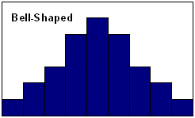
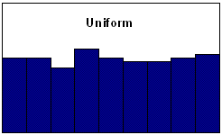
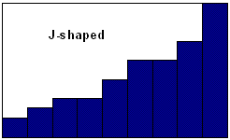
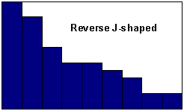

Slide 18
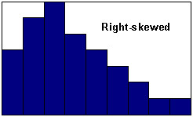
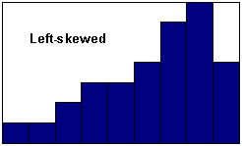
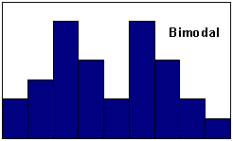
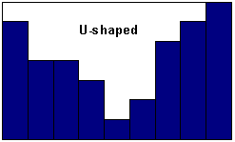

Slide 19
Things to look for when making graphs:
The GENERAL shape…(from 3 slides ago)
How are the data values spread out: centered around a point/the center, evenly spread out, etc
Are there any/many extreme values (outliers)
Are there gaps

Slide 20
ASSIGN: p. 67 and 68: 13, 17, 19, 20 + go back and look at the SHAPES from last assignment

Slide 21
2-3: Other Types of Graphs
Bar graphs
Pareto Charts
Time Series Graphs
Pie Graphs
Dot Plots
Stem and Leaf Graphs
Misleading Graphs

Slide 22
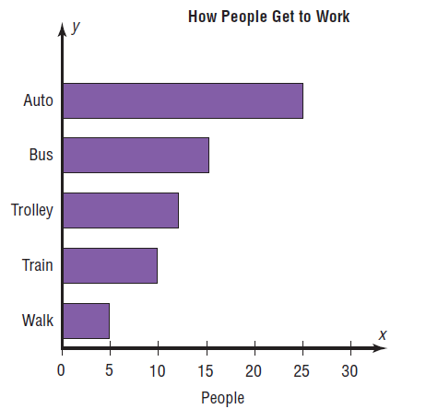
Bar Graphs: Represents the data using vertical or horizontal bars where the heights/lengths represent the frequencies of the data
**Notice how the x values aren’t boundaries anymore**

Slide 23
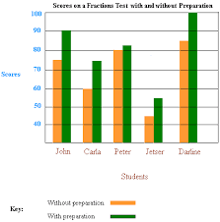
Compound bar graphs: when multiple bars are stacked next to each other to represent more than one set of data at the same time
Allows data to be easily compared

Slide 24
Pareto Chart: Vertical bar graph with categories on x-axis
Arranges data from largest to smallest according to frequency
----------------stop here today (look at examples)
Time Series Graph: represents data that occur over a given period of time
Plot points and connect them with a line

Slide 25
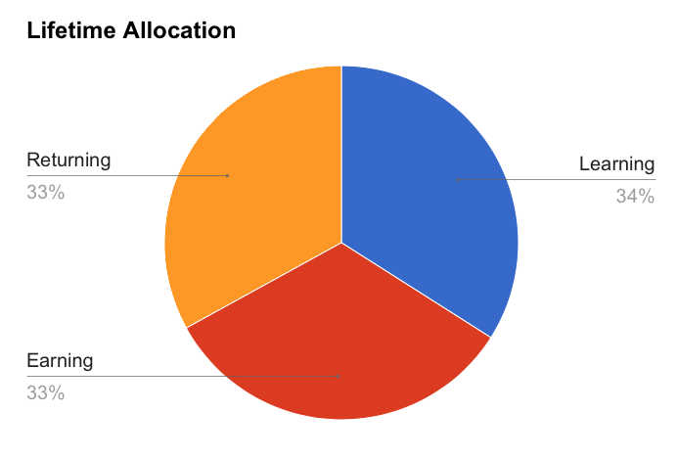
Pie Graph/Chart: a circle that is divided into sections (pieces of pie) that represent the different percentages in each category

Slide 26
To find pie chart section values:
Degrees = $\frac{frequency}{sum of frequencies}$ x 360º
%’s = $\frac{frequency}{sum of frequencies}$ x 100
-------stop here today and look at examples

Slide 27
Dot Plots: it really is just a bar graph where the bar is dots
Used to show extremely high or low values (outliers)

Slide 28
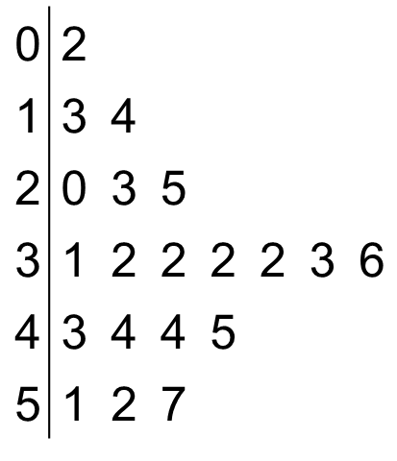
Stem and Leaf Plots: actually uses part of the data value IN the graph.
Example…
Stem Leaf
Let’s look at hints and steps…p. 84

Slide 29
Misleading Graphs: graphs that guide the viewer purposefully into false conclusions
Truncated axes (p. 87/88)
Bars/figures (p. 89)
Graph creator needs to exercise caution to not improperly influence the graph reader

Slide 30
Misleading Graphs: (continued)
All graphs should contain a source for who is representing the information (that is often a great clue as to IF the graph will even be misleading or not)

