Slide 1
Chapter 6: The Normal Distribution

Slide 2
6-1: Normal Distributions

Slide 3
What is the normal distribution?
A normal distribution is when a continuous random variable is bell-shaped and symmetric
The mean will affect where the distribution is located on the x axis
The standard deviation will affect how skinny or stretched the distribution is

Slide 4
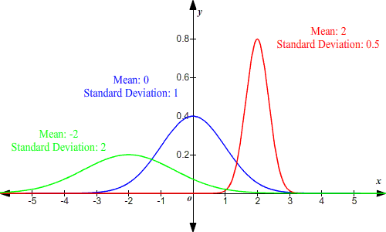
Examples with different mean/SD

Slide 5
Properties of theoretical Normal Distribution
1. Normal Distribution is bell shaped
2. Mean, median, mode located at center of distribution
3. Unimodal (has only 1 mode)
4. Symmetric about the mean
5. The curve is continuous (no gaps)
6. Never touches x axis
7. Total area is under curve is = to 1.00 or 100%
8. Area within 1 SD is 0.68, 2 SD is 0.95, 3 SD is 0.997

Slide 6
1. Normal Distribution is Bell-Shaped

Slide 7
2. Mean, median, mode at center of distribution
Mean, median, mode

Slide 8
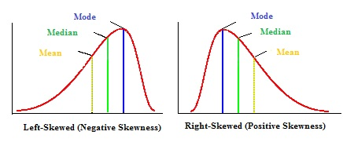
Skewed distribution
When a majority of data values fall outside the mean

Slide 9
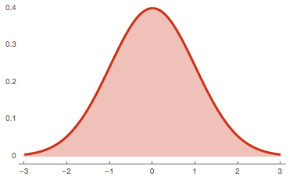
3. Unimodal

Slide 10
4. Symmetric about the mean

Slide 11
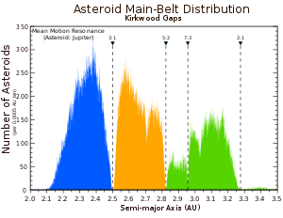
5. The curve is continuous (no gaps)

Slide 12
6. Never touches the X axis

Slide 13
7. Total area adds up to 1.00 or 100%

Slide 14
8. Area within 1 SD is 0.68, 2 SD is 0.95, 3 SD is 0.997

Slide 15
Z scores
Z = $\frac{value − mean}{standard deviation}$ Z = $\frac{X − μ}{σ}$
Z score is just number of standard deviations away from the mean

Slide 16
Finding area under standard normal distribution
1. Draw normal distribution curve and shade area you are looking for
2. Look up Z value in table in back and record probability (779-780)
3. If area is to left of Z value, then probability found is answer
4. If area is to the right of Z value, then 1 - probability

Slide 17
Example
Look up Z score in table
Since desired area on left, just record that area
Z = 0.89
0.8133

Slide 18
Example #2
Z = 1.33 Find area to the right
1 – 0.9082
= 0.0918

Slide 19
Try these on your own
Find the area to the left of the Z score 0.56
0.7123
Find the area to the right of the score -1.29
1-0.0985 = 0.9015

Slide 20
HW 6-1 day 1
P322. #8-29 every 3rd one

Slide 21
If the desired area is between two Z scores
Take the two values and subtract the lower one from the higher one
Find the area between Z = -0.13 and Z = 0.55
0.7088-0.4483 = 0.2605

Slide 22
Think of it as a rectangle
The whole area is 12. And We know that the purple area is 7. To find the area of what is left, we would just take our total minus the area of the purple and find what is left

Slide 23
On your own
0.9719-0.0643 = 0.9076
Z = -1.52
Z = 1.91

Slide 24
Try on your own
Find the area between the Z scores -2.17 and -0.99.
0.1611-0.0150 = 0.1461
Find the area given –0.45 < Z < 1.30
0.9032-0.3264 = 05768

Slide 25
What if you are given an area…
For example: Find the Z value such that the area under our standard normal distribution curve between 0 and our Z value is 0.2123
1. Draw the curve and shade in the area that you are looking for
2. Find probability in Z chart in back of book
3. If the Z score is to the right of the mean and we are starting at 0, must add point 0.50 before looking it up

Slide 26
Example continued
Z
So we have to look up 0.7123 in the Z charts and we find it to be 0.56
0.50
0.2123

Slide 27
Find the Z value to the left of the mean so that 97.78% of the distribution curve lies to the right of it
Z = -2.01
Since area is to the right, I have to take 1-0.9778 = 0.0222
And I find Z = -2.01 at 0.0222 so our desired Z score is -2.01
.9778

Slide 28
Try on your own
Find the Z score to the right of the mean so that 56.36% of the area under the standard normal distribution is to the left.
Z= 0.16
Find the Z score to the left of the mean so that 87.70% of the area is to the right of the Z score.
Z= -1.16

Slide 29
HW 6-1 Day 2
P.323 #47-51

Slide 30
Section 6-2: Applications of the Normal Distribution

Slide 31
Z scores
Z = $\frac{value − mean}{standard deviation}$ Z = $\frac{X − μ}{σ}$
Z score is just number of standard deviations away from the mean

Slide 32
Real Life Applications
With real life applications, we will have to convert the real life data to Z scores
After you convert the new problems to Z scores, then we use same procedure from section 1
Recall from chapter 1:
1. Draw normal distribution curve
2. Shade in desired area
3. Use table to determine shaded area

Slide 33
Example 1
An adult has on average 5.2 liters of blood. Assume the variable is normally distributed and has a standard deviation of 0.3. Find the percentage of people who have less than 5.4 liters of blood in their system.
1. Find the Z score
Z = $\frac{X−μ}{σ}$ = $\frac{5.4−5.2}{0.3}$
= 0.66 ←New Z
Now can use table
And we find that Z = 0.67 is 0.7486
So 74.86% have less than 5.4 liters of blood.

Slide 34
Try by yourself
Each month, an American household generates an average of 28 pounds of newspaper for garbage or recycling. Assume the variable is approximately normally distributed and the standard deviation is 2 pounds. If a household is selected at random, find the probability of generating between 27 and 31 pounds per month.
Z1= -.05 Z2= 1.5

Slide 35
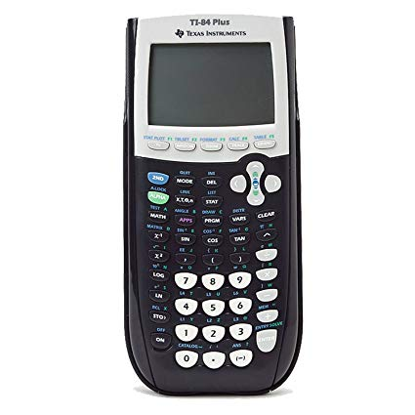
Also, we have technology
So we can also use calculators instead of/in addition to Z tables
1. 2nd → Distr (Vars) then scroll to normalCDF
2. Inside normalCDF(lower Z value, higher Z value)
3. If we need to use infinity/negative infinity, 2nd →[EE] to get E
E99→+infinity -E99→-infinity

Slide 36
Let’s try it
Find the area to the left of z = -1.93
0.0268
Find the area to the right of z = 1.11
0.1335
You can use either one, but still show work
Also can be used to verify

Slide 37
6-2 Homework Day 1
P337 #1-4, 6, 13

Slide 38
Sometimes need to find X value
Z = $\frac{X − μ}{σ}$
Z * $σ$ = X – $μ$
Z * $σ$ + $μ$ = X ← Formula for find value of Normal Variable X

Slide 39
Procedure for Finding Data Values for specific probabilities
Step 1: Draw a normal curve and shade the desired area that represents the probability, proportion, or percentile.
Step 2: Find the Z value from the table that corresponds to the desired area
Step 3: Calculate the X value by using formula : Z * $σ$ + $μ$ = X

Slide 40
Example 1
To qualify for a police academy, candidates must score in the top 10% on a general abilities test. Assume the test scores are normally distributed and the test has a mean of 200 and a standard deviate of 20. Find the lowest possible score to qualify.
Still start out by drawing our distribution.

Slide 41
Continued
The closest Z value is 1.28. Now that we know the mean, SD, and Z value, we can find our X value.
X=1.28(20) + 200
X =225.6
But we will round to 226 to qualify for academy, one needs a 226.
Work backwards for this problem:
1. We know that 90% of area will be to the left of unknown Z value. So let’s use our table!
200
X

Slide 42
Try on your own
A researcher needs to find the middle 60% of the population based on blood pressure. Assuming the mean blood pressure is 120 and the standard deviation is 8, find the upper and lower readings that would allow someone to be in the middle 60%.

Slide 43
Determining normality
We are not always sure if distributions are normal, so we have to check for skewed ness.
Usually we can just check the shape of the histograms
We can check for Skewedness with Pearson Coefficient (PC)
PC = $\frac{3(mean −median)}{standard deviation}$
If PC is greater than +1 or less than -1, then our data is significantly skewed
Other wise it is approximately normal

Slide 44
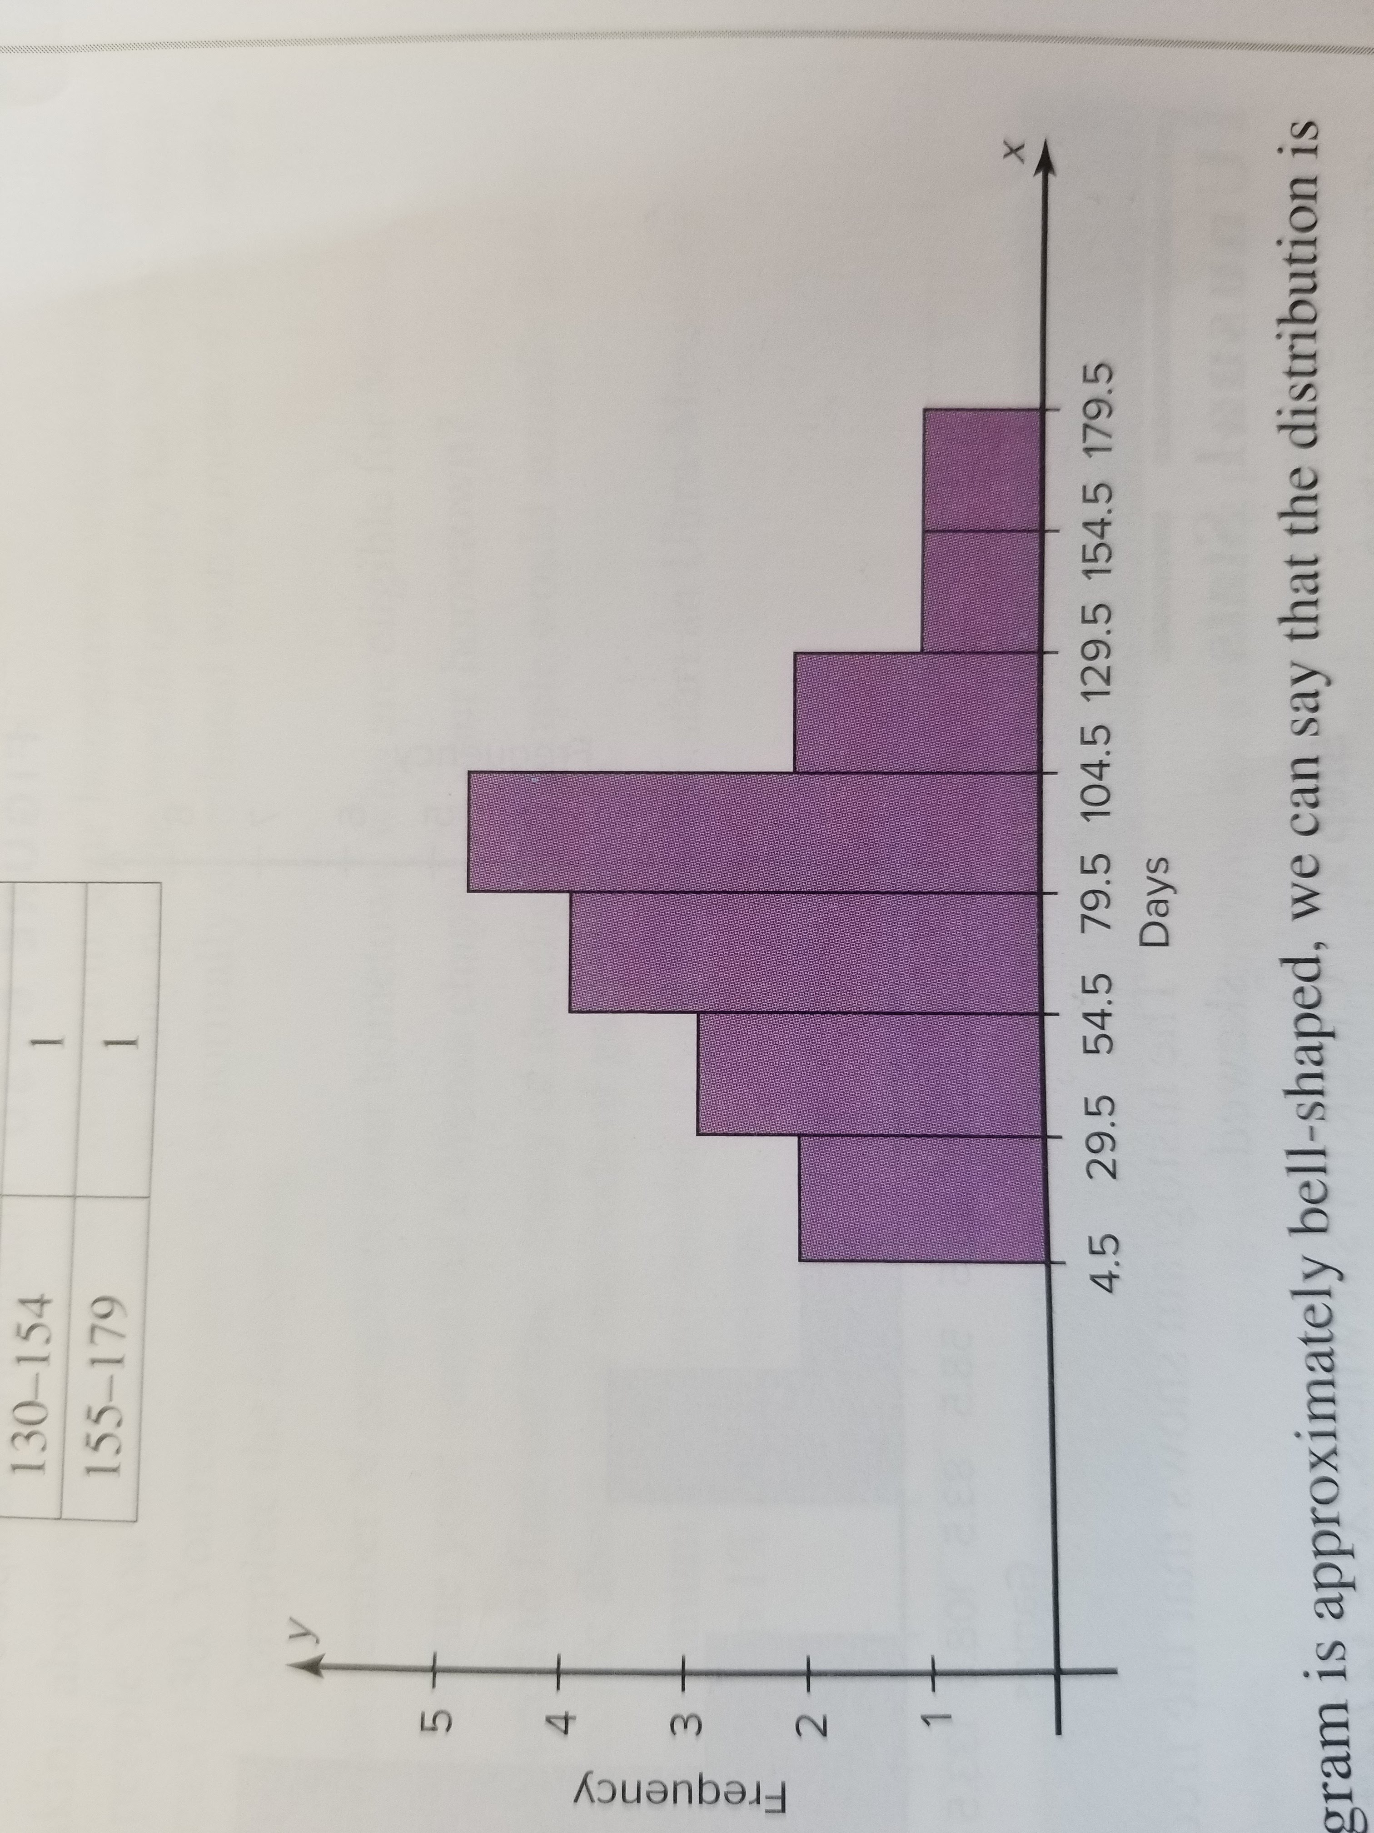
Let’s check for Skewedness
Class | Frequency
5-29 | 2
30-54 | 3
55-79 | 4
80-104 | 5
105-129 | 2
130-154 | 1
155-179 | 1
X‾= 79.5, Median=77.5, S = 40.5
PC=$\frac{3(79.5 −77.5)}{40.5}$ =0.148 so not skewed significantly

Slide 45
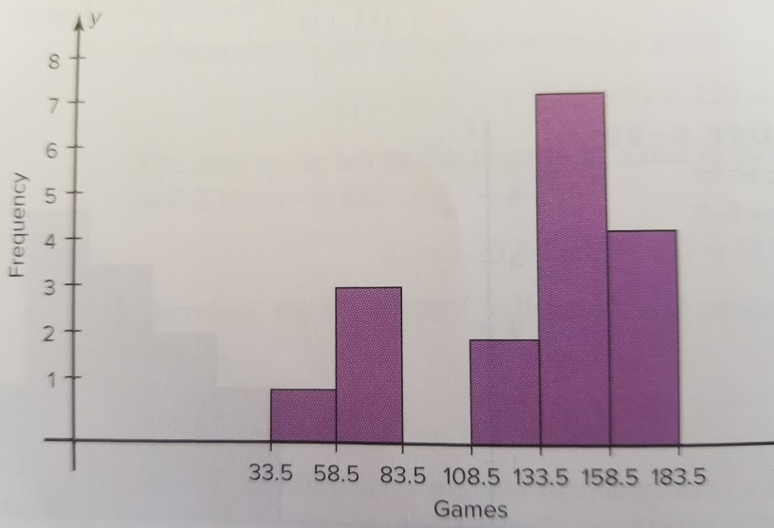
Example for you to try
Class | Frequency
34-58 | 1
59-83 | 3
84-108 | 0
109-133 | 2
134-158 | 7
159-183 | 4
Find the PC and determine if skewed.

Slide 46
HW Section 6-2
P.339 19,24,26,30,42

Slide 47
Section 6-3 The Central Limit Theorem
Dealing with non-normal distributions:
When we have non-normal distributions, how do we understand them
Take lots of samples of the same sample size
The means of those samples approach a normal distribution

Slide 48
Example
A professor gave four students a test and they scored a 2,4,6, or 8.
Assuming this was the population, the μ = 5.

Slide 49
Example
A professor gave four students a test and they scored a 2,4,6, or 8.
Assuming this was the population, the μ = 5.
σ = 2.236
n = 2
Sample | Mean | Sample | Mean
2,2 | 2 | 6,2 | 4
2,4 | 3 | 6,4 | 5
2,6 | 4 | 6,6 | 6
2,8 | 5 | 6,8 | 7
4,2 | 3 | 8,2 | 5
4,4 | 4 | 8,4 | 6
4,6 | 5 | 8,6 | 7
4,8 | 6 | 8,8 | 8

Slide 50
Continued
$$\overline{X}$$ | f
2 | 1
3 | 2
4 | 3
5 | 4
6 | 3
7 | 2
8 | 1
So this appears to follow a normal distribution after we find the frequency of the sample means
In other words $μ_{\overline{X}}$ = 5
$σ_{\overline{X}=1.581}$which is the same Population SD/$\sqrt{2}$ = 1.581.

Slide 51
Let’s get to the Central Limit Theorem
As the sample size increases without limit, the sample means and standard deviations will approach a normal distribution
Get to use if sample is larger than 30 people
This is a huge idea that allows us more insight in the normal distribution
Z = $\frac{\overline{X}−μ}{σ/\sqrt{n}}$

Slide 52
Example
The average drive to work is 9.6 miles. Assume the standard deviation is 1.8 miles. If a random sample of 36 employed people who drive to work are selected, find the probability that the mean of the sample miles driven to work is between 9 and 10 miles.
Step 1: Draw a normal curve and shade the desired area. Since the sample is 30 or larger, we do not have to assume normality
Step 2: Convert $\overline{X}$ to z values
Step 3: Do what we have been doing to find desired area under curve

Slide 53
Step 1:

Slide 54
Step 2:
Converting $\overline{X}$ to z values using our new formula
First I like to clear up what all my variables are:
$\overline{X}$ = 9,10 μ = 9.6, σ = 1.8 , n = 36
$z_{1}= \frac{9−9.6}{1.8/\sqrt{36}}$ = -2
$z_{2}$ = $\frac{10−9.6}{1.8/\sqrt{36}}$ = 1.33

Slide 55
Step 3:
The area for Z =-2 is 0.0228
The area for Z = 1.33 is 0.9082
0.9082-0.0228 = .8854
So the probability that the mean mileage driven to work for a sample size of 36 is between 9 and 10 is 88.54%
Done!!

Slide 56
Example for you to try
The average time spent by construction workers who work on weekends is 7.93 hours (over two days). Assume the distribution is approximately normal and has a standard deviation of 0.8 hour. If a sample of 40 construction workers is randomly selected, find the probability that the mean of the sample will be less than 8 hours.
Z= 0.55 , The probability of getting sample mean of less than 8 hours when the sample size is 40 is 0.7088

Slide 57
Determining which formula to use
Use Z = $\frac{\overline{X}−μ}{σ/\sqrt{n}}$ when you have information about a sample mean
Use Z = $\frac{\overline{X}−μ}{σ}$ when gaining information about an individual

Slide 58
HW 6-3
P. 352 #8-12 all

Slide 59
6-4 The normal approximation to the binomial distribution
Recall from chapter 5
A binomial distribution has:
Fixed number of trials
Outcome must be independent of one another
Each experiment can have only two outcomes
Probability of success is the same for each trial

Slide 60
When does binomial approach normal
When p is approximately 0.5 and as n increases the shape of the binomial distribution becomes similar to a normal distribution
When p is close to 0 or 1 and n is relatively small, then the normal approximation is inaccurate
General rule of thumb n*p ≥ 5 and n*q ≥ 5

Slide 61
Correction for continuity
We have to use this because binomial is discrete and normal is continuous

Slide 62
A couple of examples for correction for continuity
To find P(X = 8) we would actually look for X = 7.5 and X = 8.5
To find P(X ≥ 8) we would actually look for X ≥ 7.5
To find P(X ≤ 8) we would actually look for X ≤ 8.5

Slide 63
Also we remember how to find Binomial SD and mean
μ = n*p
σ = $\sqrt{n∗p∗q}$

Slide 64
Procedure
Step 1: Check to see if normal distribution can be used
Step 2: Find the mean μ and the standard deviation σ
Step 3: Write the problem in the probability notation, using X
Step 4: Rewrite problem with continuity correction factor, and show corresponding area
Step 5: Find corresponding Z values
Step 6: Find the solution

Slide 65
Let’s go through one together
It has been reported that last year 25% of drivers have fallen asleep at the wheel. If 200 drivers are selected at random find the probability that 62 will say that they have fallen asleep while driving.

Slide 66
Step 1:
Notice n = 200, p = 0.25, q = 0.75
n*p = (200*0.25) = 50 , n*q = (200*0.75) = 150
Since both greater than or equal to 5, we can go ahead.

Slide 67
Step 2:
Mean = μ = np = (200)(0.25) = 50
SD = σ = $\sqrt{npq}= \sqrt{(200)(0.25)(0.75)}= \sqrt{37.5} ≈6.12$

Slide 68
Step 3:
P(X = 62)

Slide 69
Step 4:
P(62-0.5 < X < 62 + 0.5) = P(61.5 < X < 62.5)
62
50
61.5 62.5

Slide 70
Step 5:
Remember because of correction for continuity we have to find both z scores (for 61.5 and 62.5)
$Z_{1}$= $\frac{61.5 −50}{6.12}$ ≈ 1.88
$Z_{2}$= $\frac{62.5 −50}{6.12}$ ≈ 2.04

Slide 71
Step 6:
Z = 2.04 is 0.9793
Z = 1.88 is 0.9699
0.9793 – 0.9699 = 0.0094
So there is a 0.94% chance that exactly 62 people would say they fell asleep in a sample of 200.

Slide 72
Your try!
10% of Americans are allergic to ragweed. If a random sample of 200 people is selected, find the probability that 10 or more will be allergic to ragweed.
The probability that 10 or more people would be allergic to ragweed in a sample of 200 people is 99.34%

Slide 73
HW 6-4
P360 #6, 9-12

Slide 74
Review Problems
P362 #2-22 even
Day 2 extras: 18-19abcd, 20-32 even

